Slide 1


Slide 2
Conference Theme
Guided Pathways: Lea(r)ning into future trends
Our College is engaging in three (3) system-level changes:
Fostering equitable outcomes in all of our professional practices;
Designing and evaluating Guided Pathways; and
Successfully implementing ctcLink.
These change initiatives require our ability to hone our skills in the following Essential Practices:
Change: how well we prepare for and adapt to equity-focused changes that occur within the organization and how well we support one another and work together.
Growth: the extent to which we create equitable opportunities to develop and advance both for ourselves and for others at Clark College and our community.
Engagement: the level of emotional and intellectual commitment we have towards our jobs and whether we have the right skills and resources to make a valuable and equitable contribution.
Readiness: the extent to which we have the skills, abilities, willingness, and knowledge to implement change with an intentional focus on equity.
Goal-setting: how well we know, own and can impact our success and the success of Clark College by connecting our contributions to the overall goals of the College.
Notes:
Welcome to Teaching and Learning Days. Clark is engaged in 3 system-level changes including “successfully implementing ctcLink” Today’s session focuses on both change and readiness – because having information and seeing the system helps to reduce anxiety and provide you with information to be ready for our transformation to PeopleSoft.

Slide 3


What to Expect in ctcLink
Student Focus
~ Susan Maxwell
Notes:
Today’ session – What to Expect in ctcLink, a student focus.
Tomorrow at 11am I will be introducing the college to PeopleSoft and what it looks like for an employee.

Slide 4
10 – 28 – 2019
74 days to GoLive

Slide 5
When do we have access to PeopleSoft?
Sunday 10/27 | Monday 10/28 | Tuesday 10/29 | Wednesday 10/31 | Thursday 10/31
SMES | Legacy Super Users | Non Legacy Users |  | Students
EC | Supervisors | Faculty Advisors |  | ECD Students
IT Service Center | Administrative Support | Faculty
Tech Hub | Club Advisors
Notes:
Groups will receive an email with the link to be able to sign in as a new user. Reminder – write down that PS ID when you see it, or else you will need to call the help desk.
Students will not access the system until Thursday. This allows time for staff to review student records and enter any data as necessary.

Slide 6
How will I know what to do?
Instructor led classes, by SBCTC staff via webex
Self-paced course in Canvas
ctcLink Reference Center – Quick Reference Guides (QRG)
Videos
Open Labs
Clark led classes
Ask a SME
Notes:
There are many ways available to you to learn about PeopleSoft. We are in the process of scheduling sessions. I will talk about these more tomorrow.

Slide 7
How will students know what to do?
Email
Videos on website
MyClark ctcLink Quick Reference Guides
Open Labs
Tech Hub available in Gaiser
MyClark Triage Center
College 101
Notes:
How will student know what to do?
Beginning of fall term we will begin communications to students. At GoLive we will have a variety of resources available. Discuss the list.

Slide 8
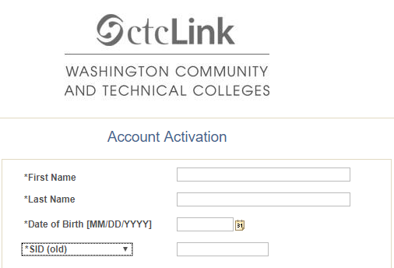
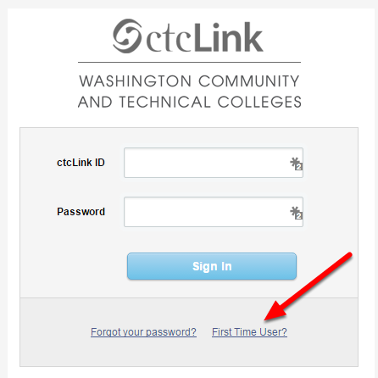

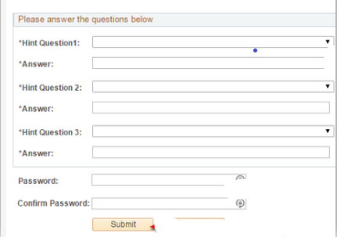
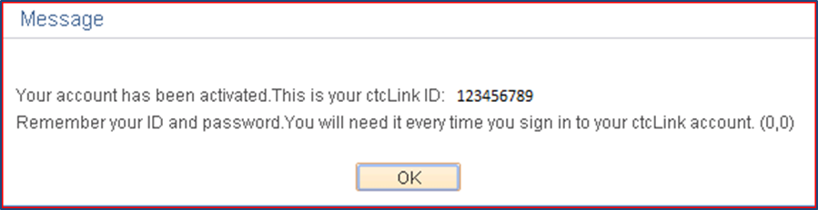
  Logging Into ctcLink
  – for the first time
ctcLink – Live
First time logging in and activating your ctcLink Account
  Click on First Time User
  Enter Required information
  Change ctcLink ID to SID (old)
  Answer Security Questions
  Write down your ctcLink ID

Slide 9
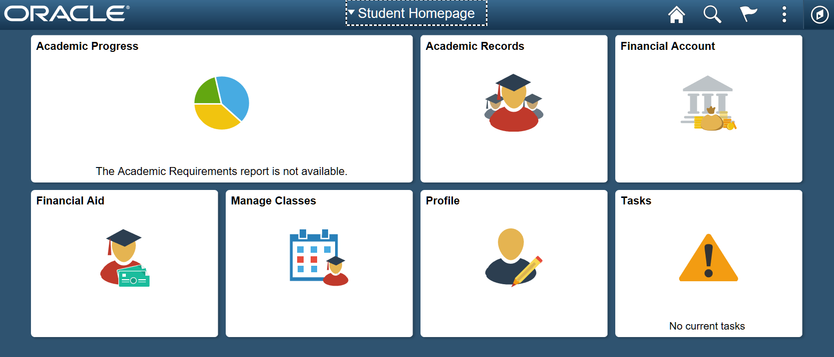
Notes:
This is the Student Homepage. One place for students to get all their information in PeopleSoft. This is the new version 9.2 of PeopleSoft Campus Solutions and you are seeing the new fluid interface.
SBCTC Created this Student Homepage and determined what tiles to include. So if you see PeopleSoft not at a WACTC it may look slightly different.

Slide 10
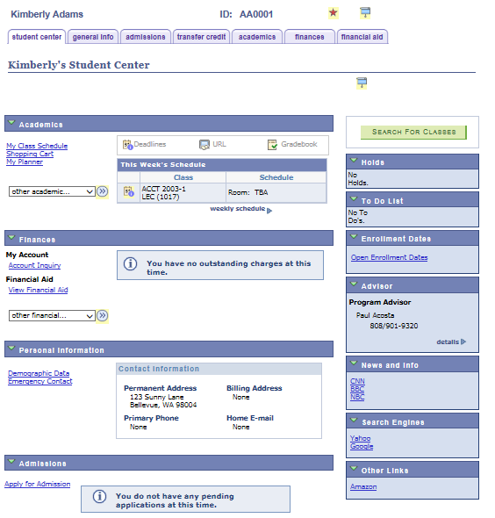
Classic View of Student Center

Slide 11
Things to know
Academic Career – students may have two academic careers
  CNED – Continuing Education
  UGRD – Undergraduate
Student View
  All their institutions and terms are available to the student
  Test scores belong to the student – visible by each school
Notes:
Enroll in classes differently
Separate transcripts
Much of the student information is separated by these two careers – so those working with the data need to be mindful.

Slide 12
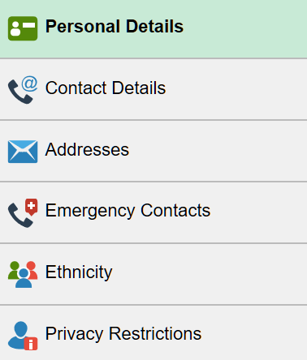
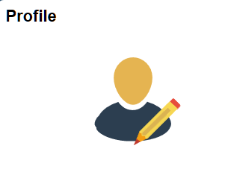

Slide 13

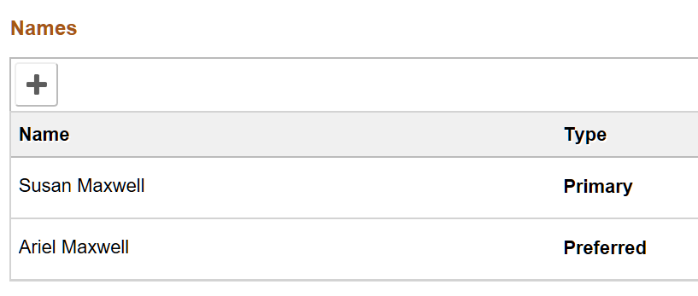
Personal details
Notes:
Primary name can be verified but not updated in self service

Slide 14

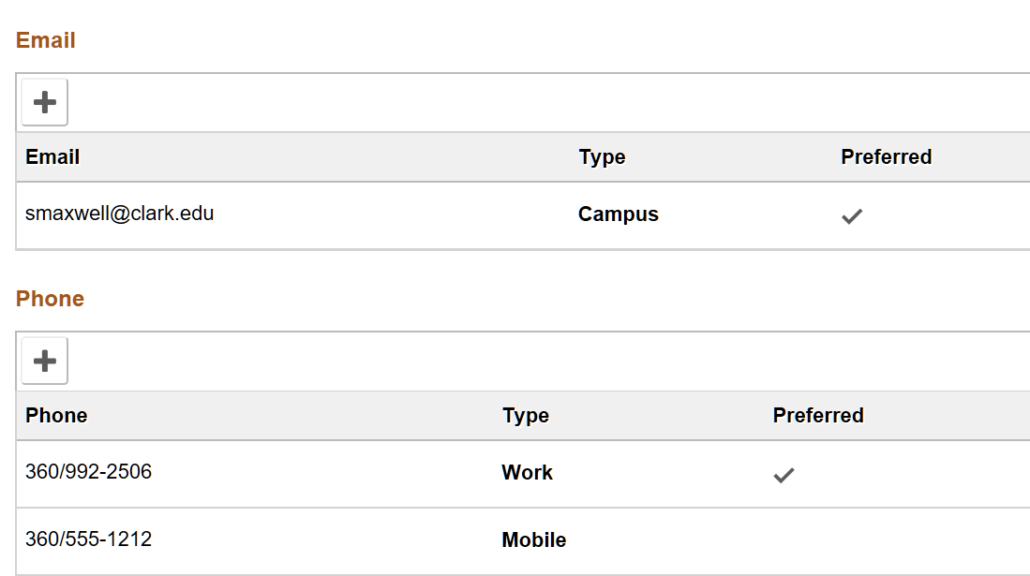
Contact Details

Slide 15

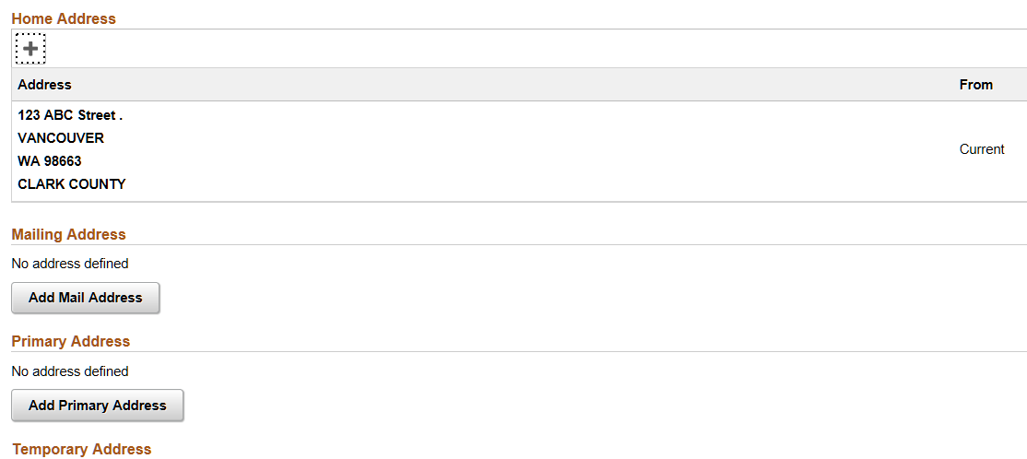
Addresses

Slide 16

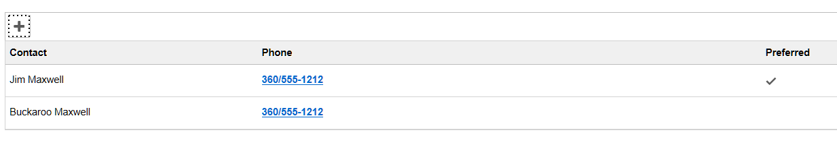
Emergency Contacts

Slide 17

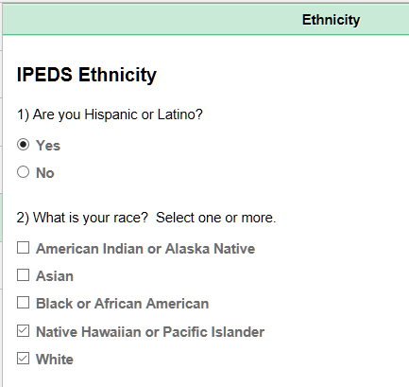
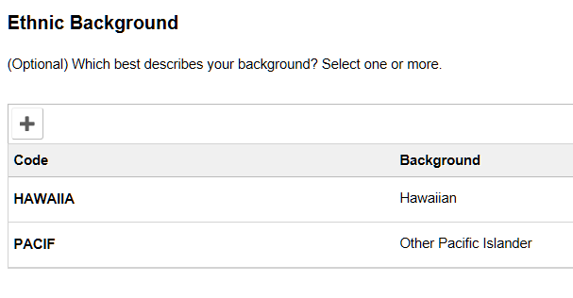
Ethnicity
Notes:
You only have the option of adding an ethnic background if you select Hispanic/Latino=yes, or Ethnicity = American Indian or Alaska Native (list of tribes), Asian or Native Hawaiian or Pacific Islander.
Good page to demo – responsiveness

Slide 18

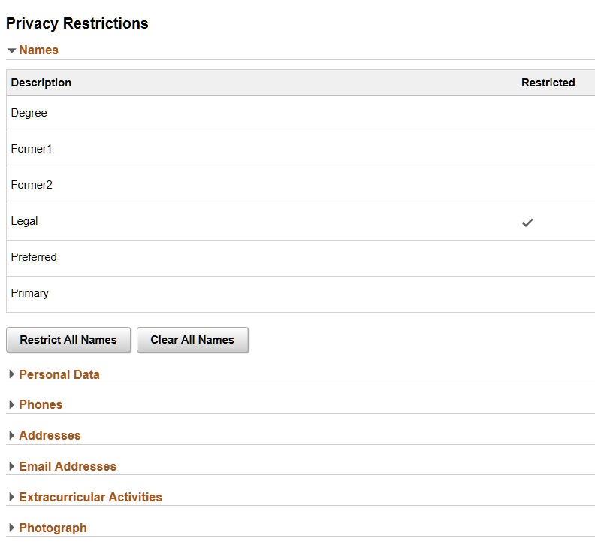

Privacy Restrictions
Notes:
When you see the “Do Not” circle it means the student has as least one FERPA restriction.

Slide 19
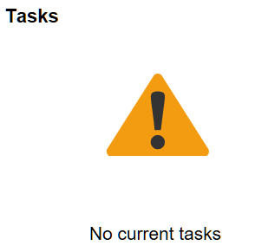
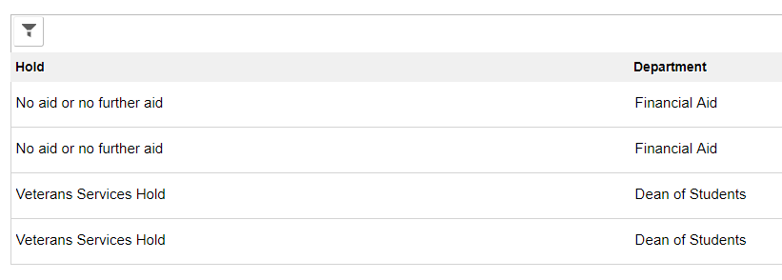
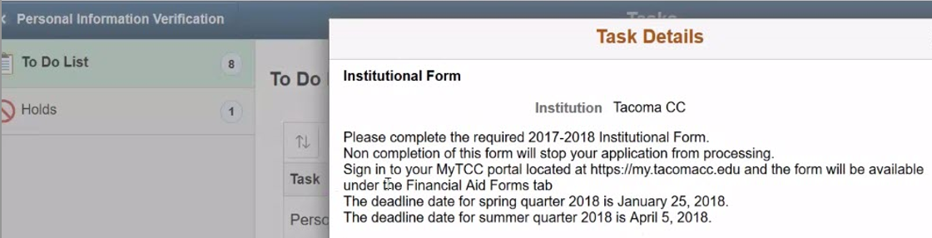
Notes:
This is where students will see Service Indicators (holds) or other tasks they need to complete. Click on the line item to see details about the task. We have provided contact information in the details of the hold.

Slide 20
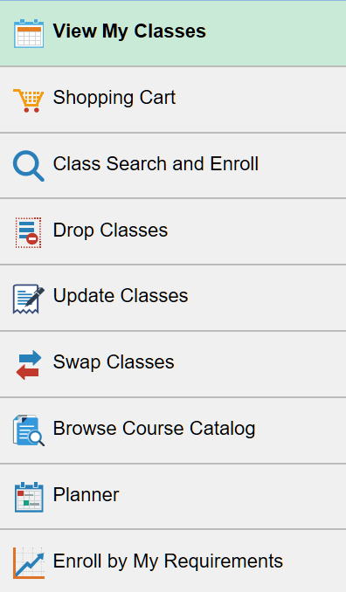
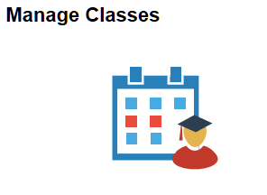

Slide 21

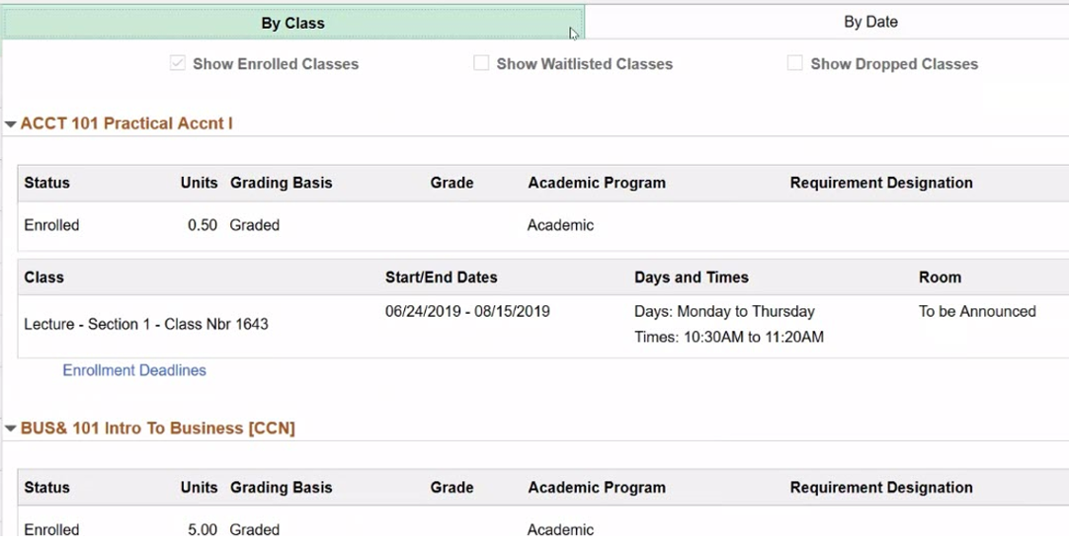
View my classes
Notes:
Students will be able to see all the schools they are enrolled at.
You can see any waitlisted or dropped classes here.

Slide 22

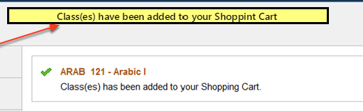
Shopping Cart

Slide 23

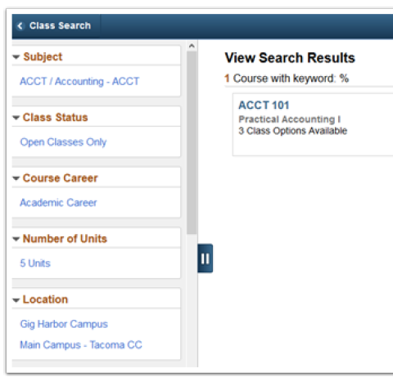
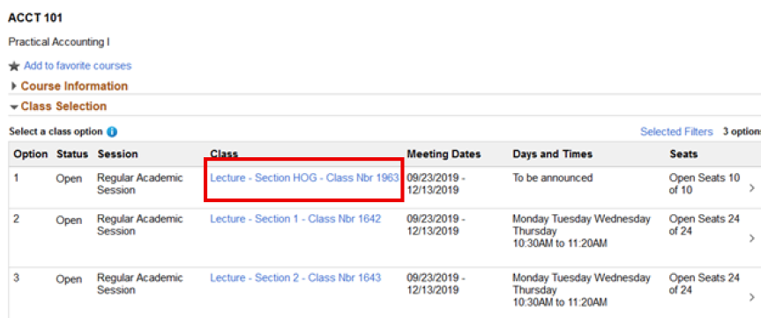
Class Search and Enroll
Notes:
3 primary ways to add classes
Browse the course catalog for a class
Add from Requirements
Add from Planner *** preferred method
Typical errors may be not meeting an enrollment requirement, a time conflict, full class, etc.
Blue = hyperlink to see details

Slide 24

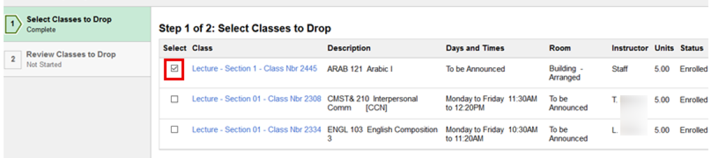
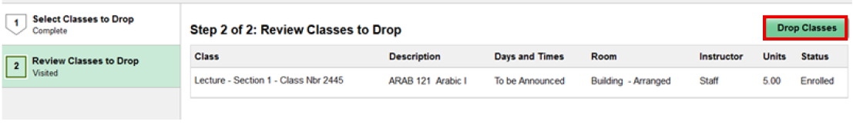
Drop Classes
Notes:
SBCTC has set up Activity Guides for some processes. This walks students through the steps they need to complete.

Slide 25

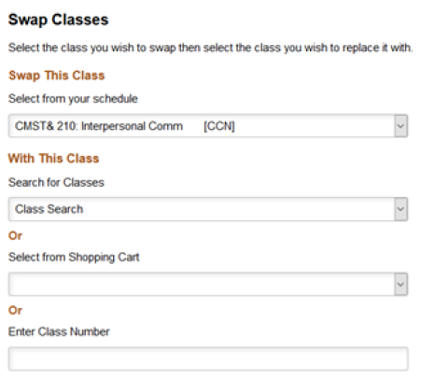
Swap classes

Slide 26

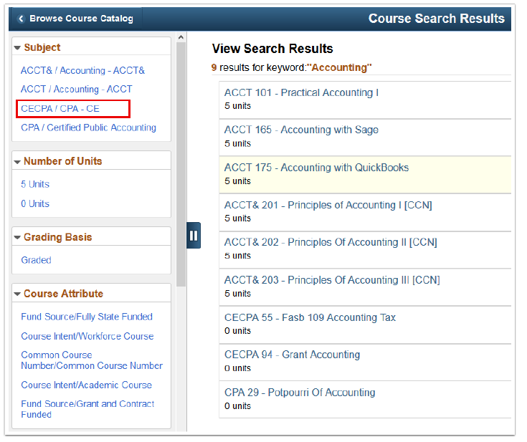
Browse course catalog

Slide 27

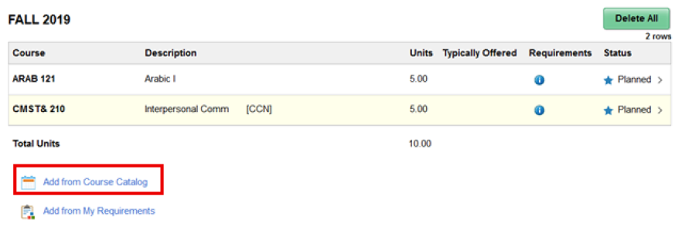
Planner
Notes:
Students will indicate what degree or certificate they are working on at Clark.
They will then have the requirements for that degree.
From those requirements they will work with their advisor to create their plan – the equivalent of the current ed plan.
Yes students can go in and rearrange their plan at any time and disregard any advice from advisors. Advisors can create a .pdf of the original planner and upload it as an attachment with notes so that it is available for reference.

Slide 28
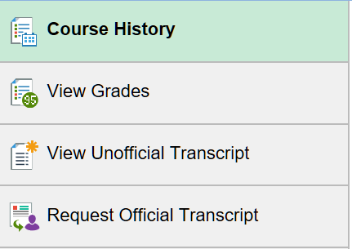


Slide 29

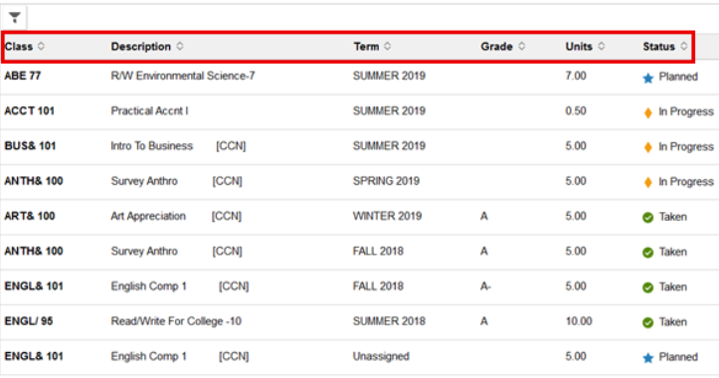
Course History
Notes:
Note the filter.
List all courses planned, in progress and taken. If taken it provides the grade.

Slide 30

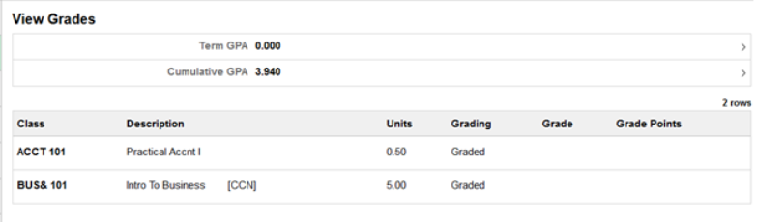
View Grades

Slide 31

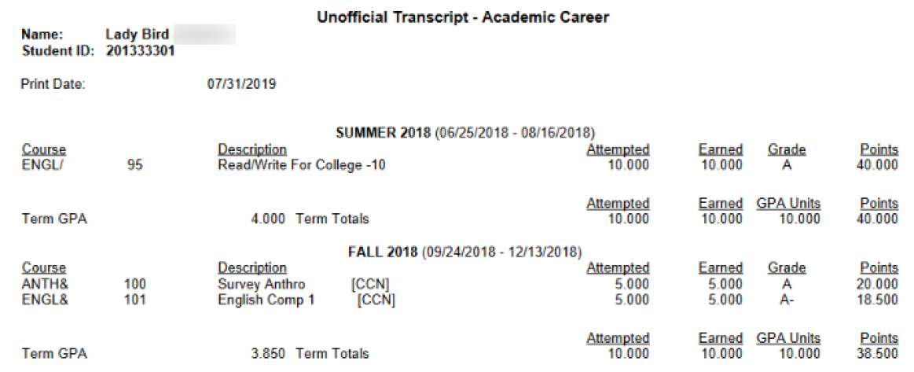
View Unofficial Transcript

Slide 32
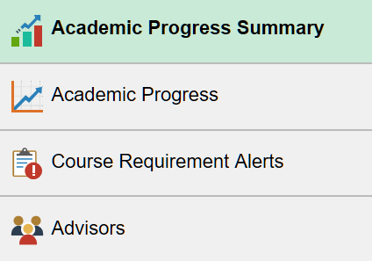
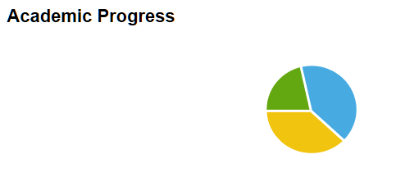
Notes:
Stanley 201420988 (student services center – fav) DOB 01/01/1982

Slide 33

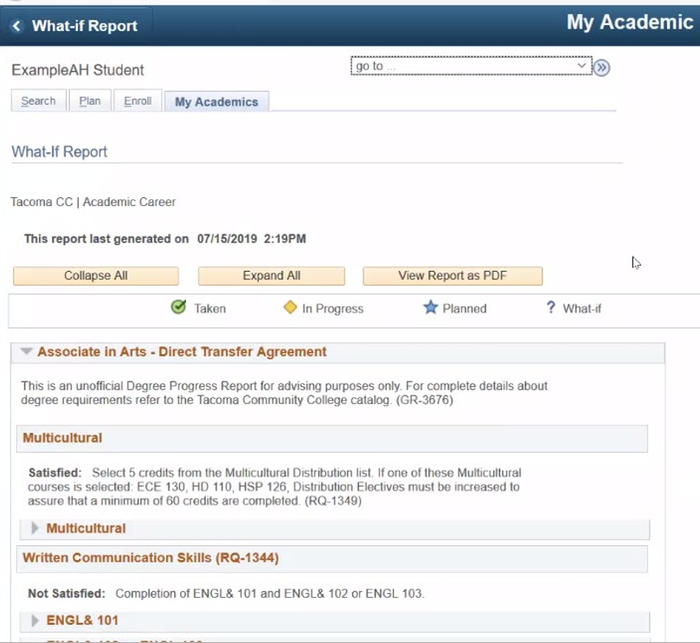
Academic Progress Summary
Notes:
Students can save as a .pdf
What-If allows a student or advisor to see how courses would be used if the student changes their program plan.

Slide 34

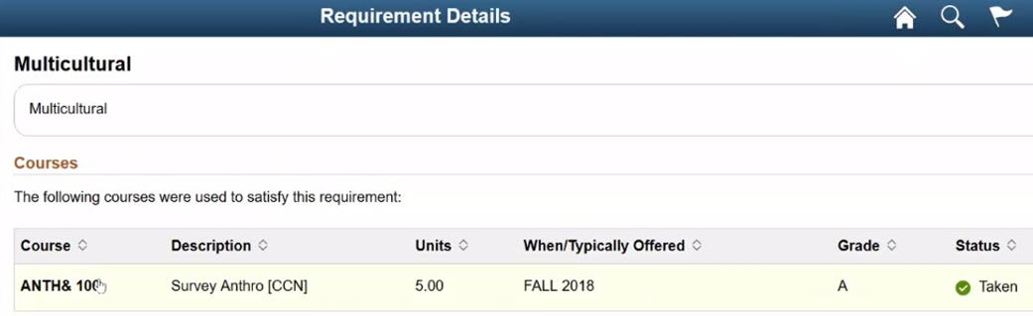
Academic Progress

Slide 35

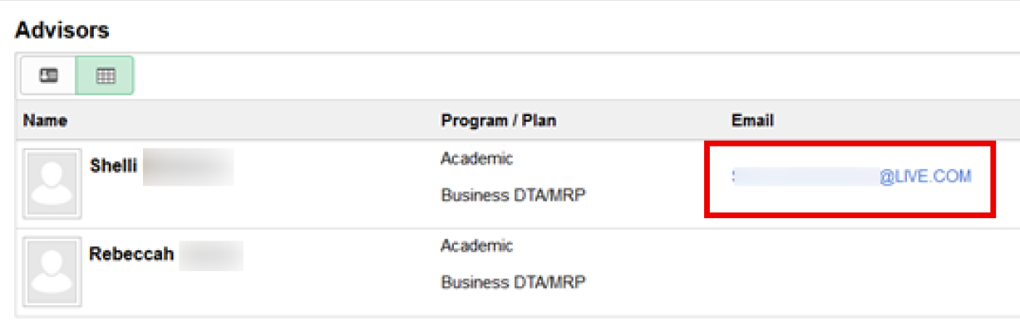
Advisors
Advisor
Contact Information
Faculty Advisor
Program “Advisor”
  WES
Notes:
We can have multiple advisors.
Email is a live link to that email. ? If

Slide 36
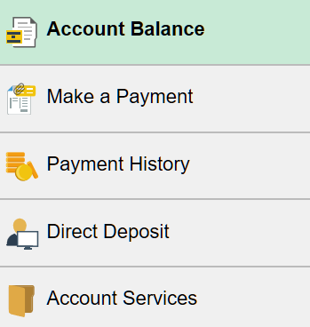
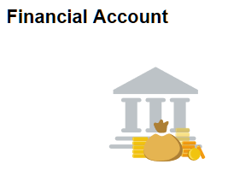

Slide 37

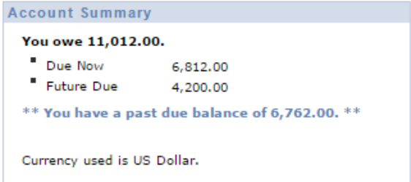
Account Balance

Slide 38

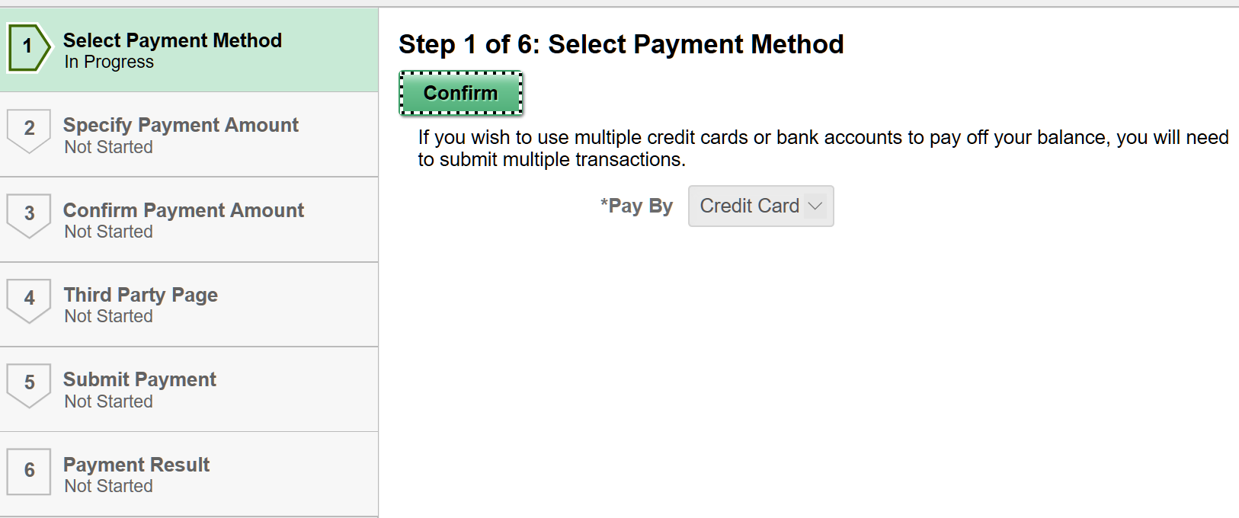
Make a payment
Notes:
This is an Activity Guide. It walks a student through the process step by step.

Slide 39

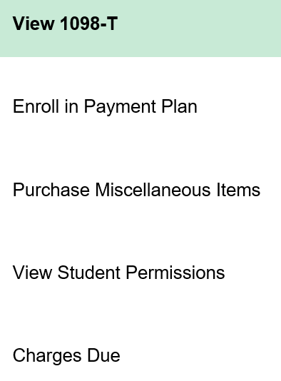
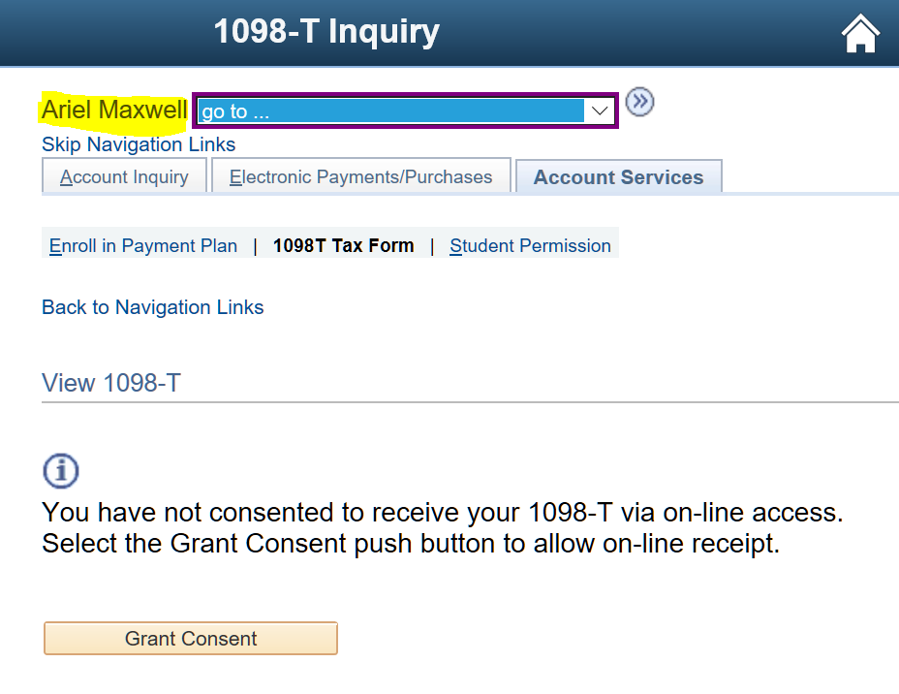
Account Services
Notes:
Note that my preferred name is displayed.

Slide 40
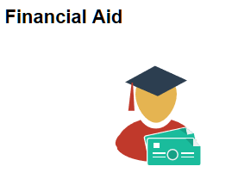
Dual Processing
2019-20 aid year will continue in FAM with student data pulled from PeopleSoft and pushed into SMS.
2020-21 aid year will switch to PeopleSoft.

Slide 41
Student Records
Test Scores
Transfer Credits – courses and tests
Milestones
Student Groups
Service Indicators

Slide 42

Questions?

